Slide 1
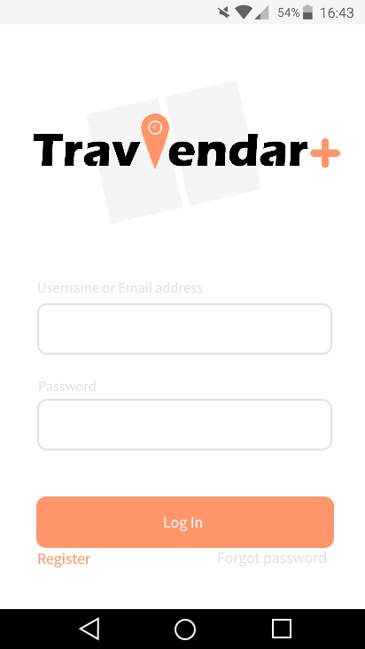
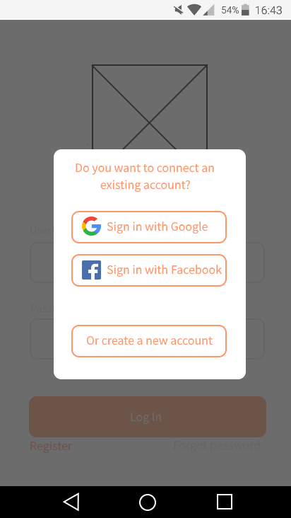
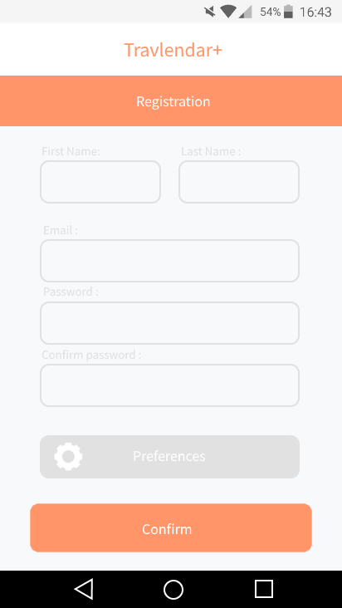
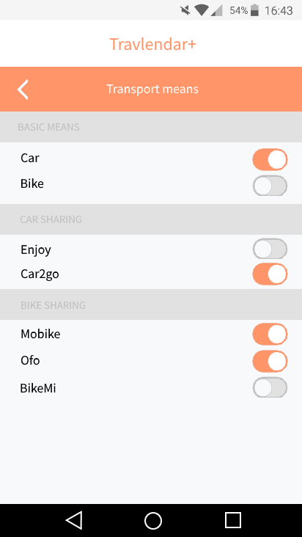
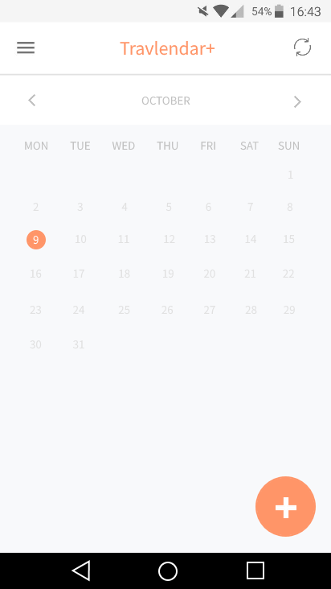
confirmAccout()
managePreferences()
Registration()
createNewAccount()
return()
logIn()
connectExistingAccount()

Slide 2
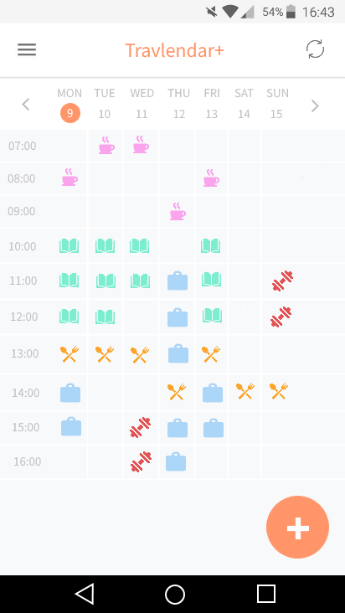
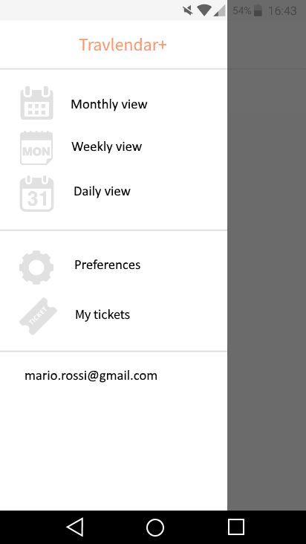
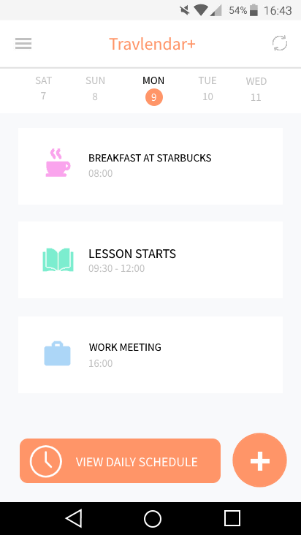
openMenu()
openMenu()
selectWeeklyView()
selectMonthlyView()
selectDailyView()
openMenu()

Slide 3
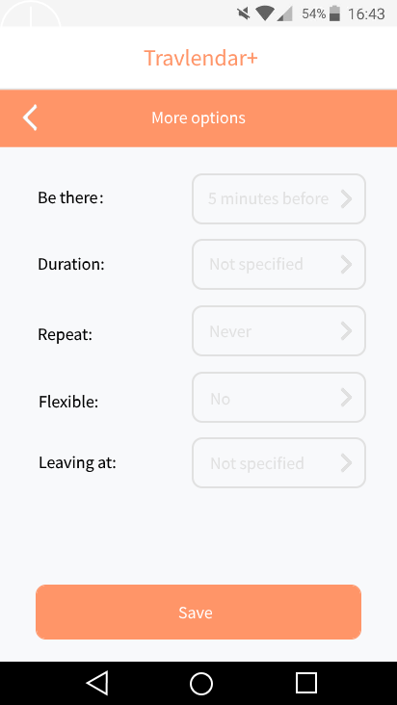
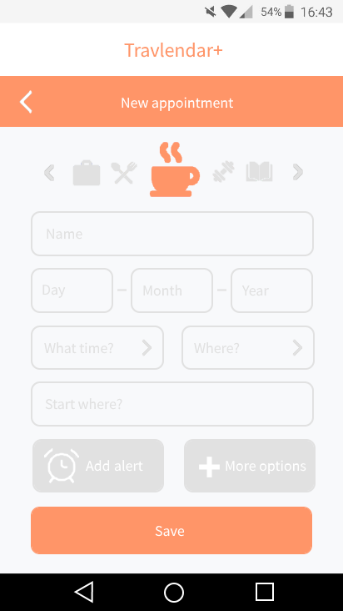
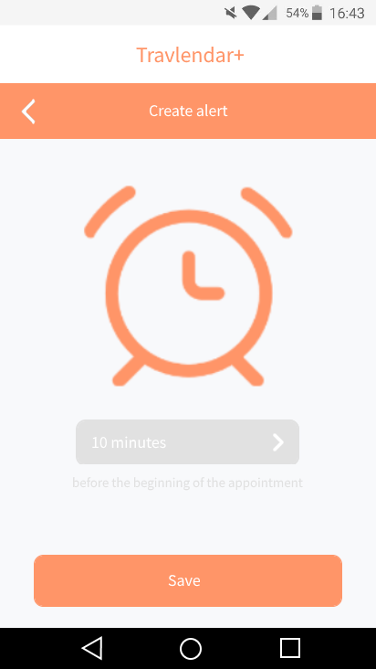
confirmCreation()
createAppointment()
confirmCreation()
confirmCreation()
createAppointment()
advancedOptions()
createAppointment()
saveOptions()
addAlert()
saveAlert()

Slide 4
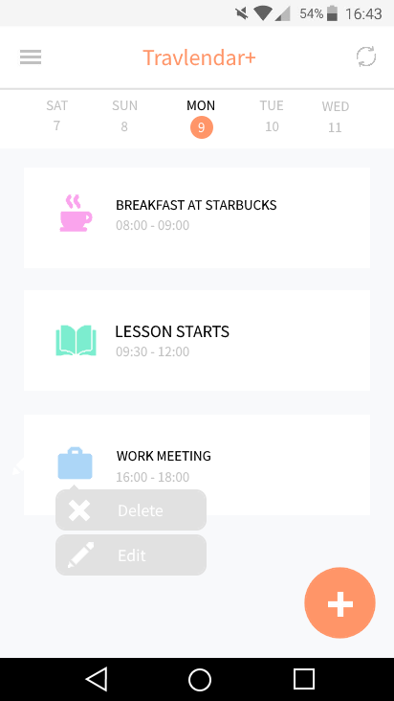
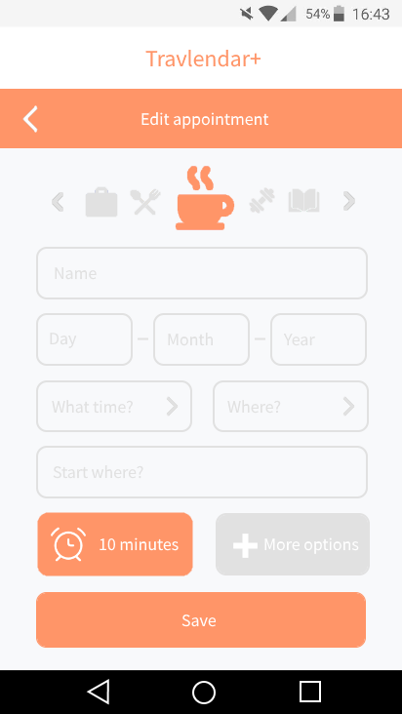
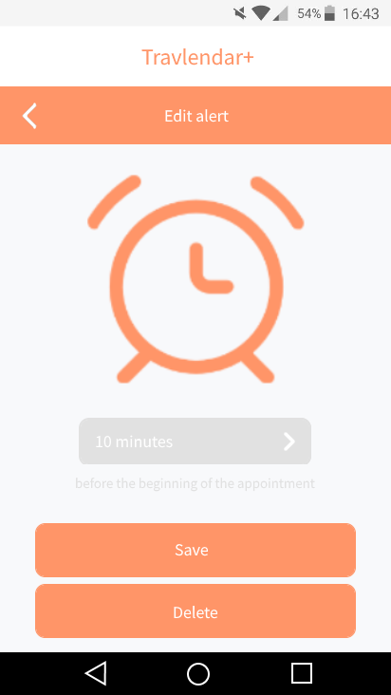
selectAppointment()
editAppointment()
saveOptions()
saveModification()
advancedOptions()
saveModificaton()
editAlert()

Slide 5
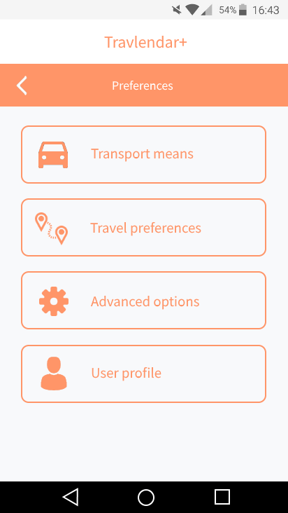
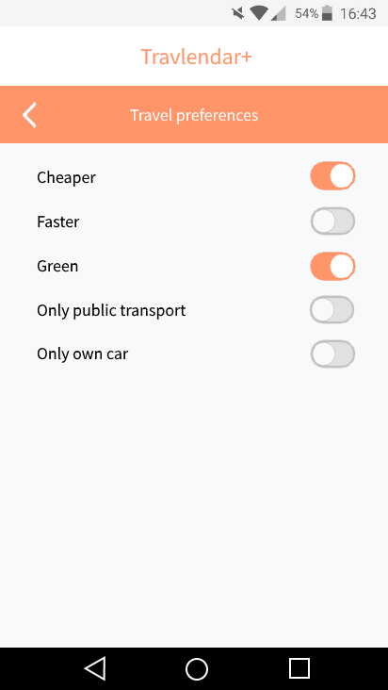
setTransportPreferences()
return()
openMenu()
openMenu()
openMenu()
openMenu()
managePreferences()
setTravelPreferences()
return()
return()

Slide 6
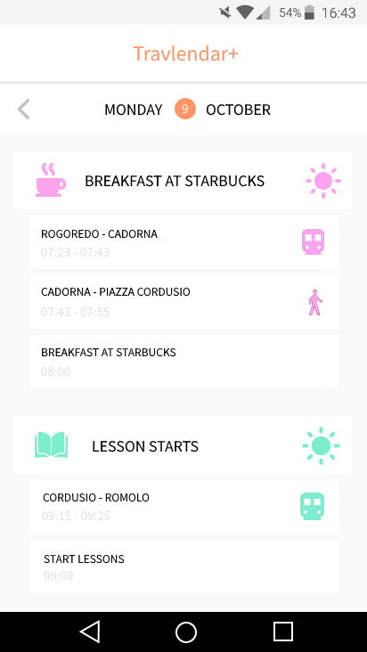
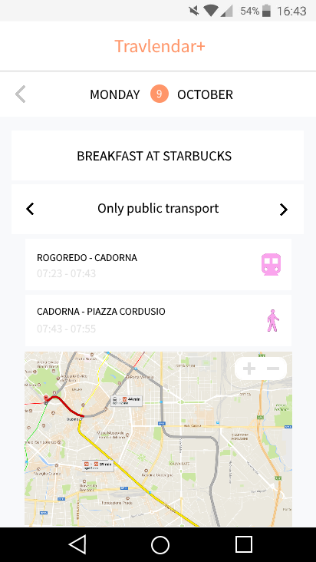
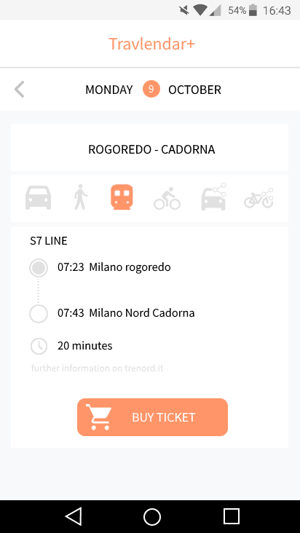
buyTicket()
viewAlternatives()
viewAlternatives()
viewDailySchedule()
selectTravel()
selectMovement()
return()
return()
return()

Slide 7
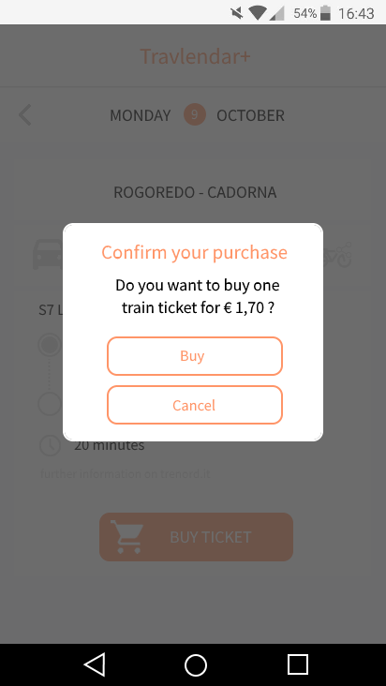
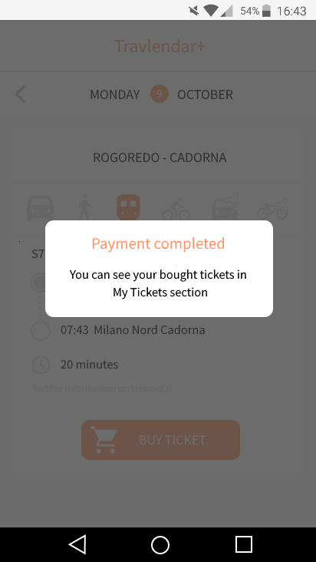
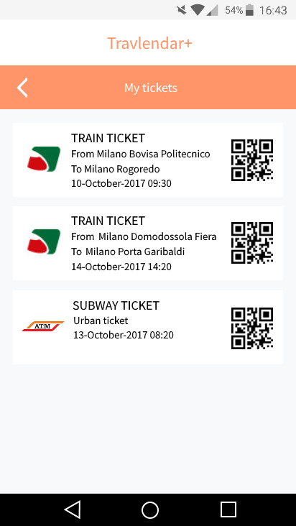
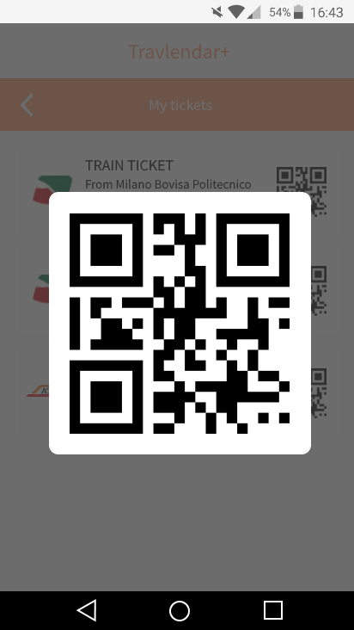
Redirect to
payment system
buyTicket()
confirmBuy()
viewMyTickets()
selectQRCode()

